Slide 1




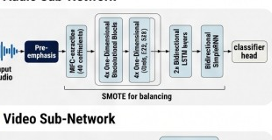
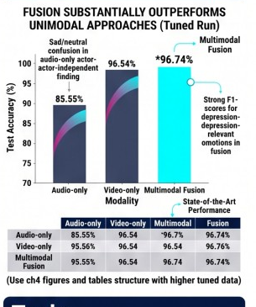
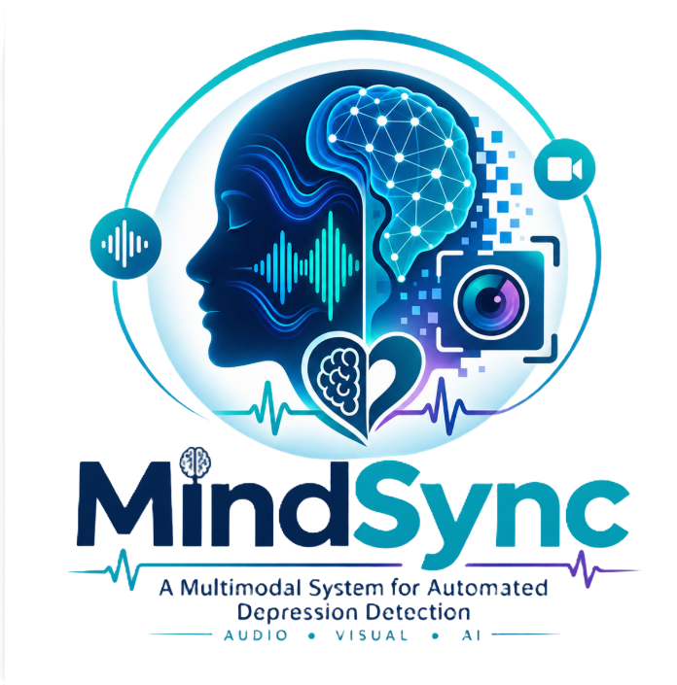
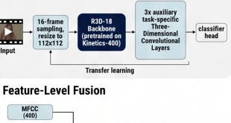
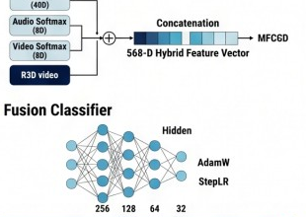
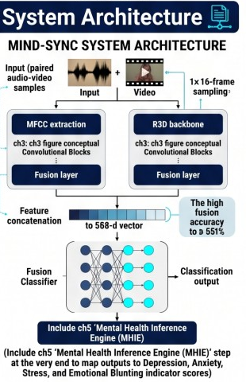
Presented by:
Bothaina Radman
Zahraa Mostafa
Basma Ftoh
Rehab Moawed
Khlood Mahmoud
Under Supervision of:
[Dr. Gouda Ismail Mohamed]
Head of Track:
Dr. Aya Hossam
MindSync: A Multimodal System for Automated Depression
Detection Using Deep Learning and Audio-Visual Signal Analysis
Abstract
Methodology
Results
MDD affects over 280 million people globally, reliant on subjective assessment. Multimodal systems like MindSync are needed to depression screening.
We propose a framework integrating independent audio (CNN+BiLSTM+RNN on MFCCs) and video (pretrained R3D-18 backbone with auxiliary 3D CNNs) sub-networks, combined via a fusion MLP. Trained on the sumputar bonin, re-mapped on RAVDESS emotions) and attrations for depression-indicator detection. The avsior is trained on RAVDESS (8 emotions) re-mapped for depression-indicator detection. Achieving state-of-the-art multimodal fusion accuracy of 96.74%.
▪ Audio Sub-Network
Aim of the Work
▪ Feature-Level Fusion
Provide clinicians with an objective, reproducible, and scalable depression-indicator screening tool .... leveraging depression-indicator axmabrralities, and passively collected audio-visual data, leveraging depression audio data, augmenting augmenting diagnostic capabilities and ... flagging individuals for comprehensive evaluation.
Live Demo
SCAN TO TRY OUR AI SYSTEM
📱 Try the Depression Screening App
Dataset
System Architecture
Conclusion
Ryerson Audio-Visual Database of Emotional Speech and Song (RAVDESS). 7,356 audio-visual recordings · 24 professional actors, 8 emotional states (Sad, Fear, Disgust, Happy, Calm, Angry, Neutral, Surprised) .... Re-mapped original emotion taxonomy to binary ‘Depressed’ (Sad, Fear) and ‘Normal’ (others) for this task...
Speech and Song subsets utilized to maximize data.
MIND-SYNC SYSTEM ARCHITECTURE
MindSync is a technically sound, modular multimodal system... Feature-level fusion effectively exploits complementary audio-visual information... achieving state-of-the-art 96.74% fusion accuracy. Mental Health Inference Engine provides interpretable clinical indicator scores. Fusion gain is consistent across evaluation protocols.
Subsets | Count | Category / Counts
Audio | 7,356 | Depressed 246
Speech | 2,000 | Sad 8 · Fear 8
Song | 333 | Disgust 24 · Neutral 16 · Surprised 3
Future Work
Domain Adaptation to naturalistic clinical datasets (e.g., DAIC-WOZ/E-DAIC)
More Modalities (EEG, Physiological, Verbal text)
Longitudinal Deployment and pattern analysis
Explainability (SHAP, Grad-CAM)
Self-Supervised backbones (wav2vec 2.0, HuBERT, TimeSformer)
(Include this finding of sad/neutral challenges as a motivation point)

